Slide 1
Bank Management System
Project by, Guided by ,
Azhagu Raja.S Dr K Thulasimani
Chella Charan.S M.E , Ph.D,MISTE,
Siva.M Professor,
Government College
Of Engineering,
Tirunelveli-627007

Slide 2
Abstract
To Simplify the process so that the User can Create a new account, deposit and withdraw money and check their balance use the Software.
To Automate the Bank management system

Slide 3
Introduction
application for maintaining a personal account in a bank
access to the customer to create an account, deposit/withdraw the cash from his account
simple console based system which is very easy to understand and use

Slide 4
Drawbacks of traditional system
Opening a new account in a bank is a tedious process
Take up a lot of time and dampen the overall customer experience.
Moreover, many people have to make time to visit a bank

Slide 5
Scope
People can sign up and open a new account in a bank digitally.
Would save a lot of time and effort.
Allow the user to make transactions, deposit and withdraw funds, and check the account balance.
User interface is user friendly

Slide 6
System Requirements
Hardware Requirements
Processor – intel core i3
Memory – 4GB RAM
Hard Disk Drive – 100GB
Software Requirements
Front end / Back end – python
Platform – Windows 7

Slide 7
Project Prerequisites
tkinter – utility to design GUI
command – pip install tkinter
Mysql- – interface for connecting to a MySQL database server from python
Pickle - Converting a Python object into a byte stream to store it in a file/database
command – pip install pickle-mixin

Slide 8
Table Design
Creating table in Database

Slide 9
Implementation
MAIN PROGRAM
Importing the modules
Connecting to MySQL server
Designing the Window
Adding a Background image
Adding Buttons
Modules
Create New Account
Log In
Send Amount
View Account
Check Balance
Transaction History

Slide 10
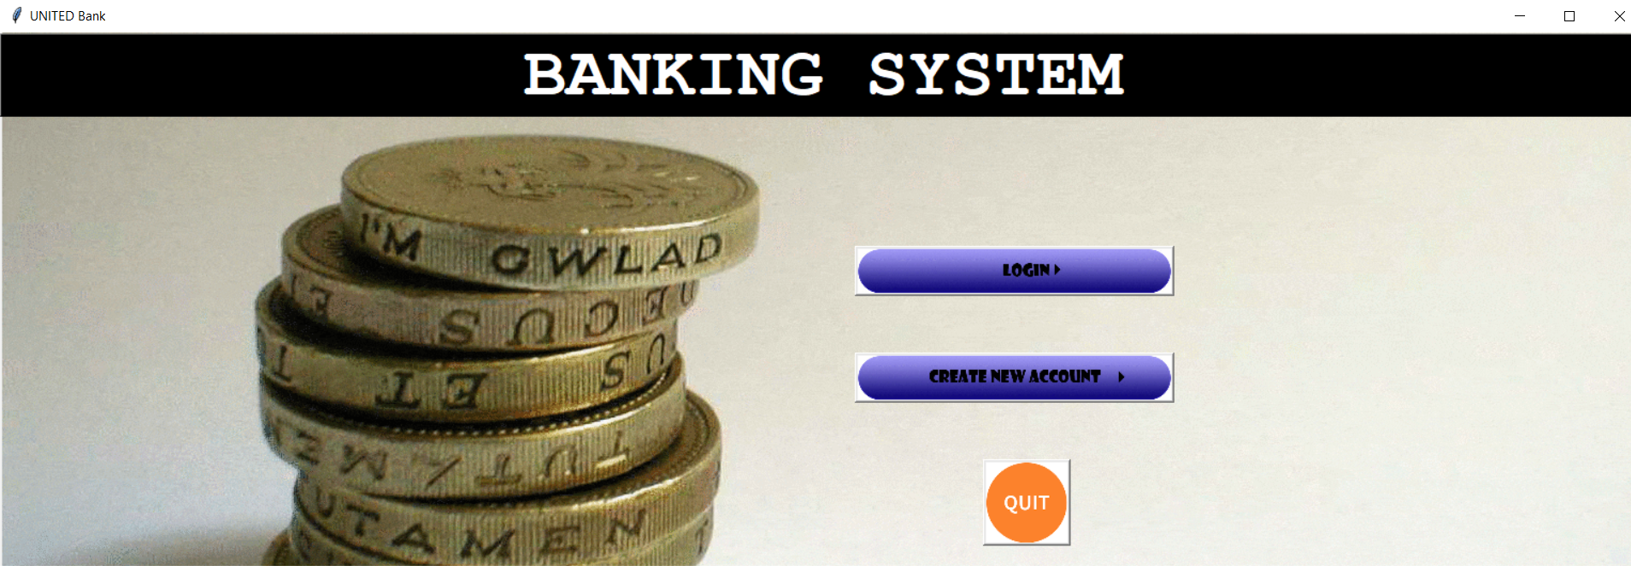
Screen Design

Slide 11
Modules (cont..)
Create New Account (Module 1)
This Module creates a New Bank Account for the User. The User has to fill in the required details in the form and press Create Account button.
A New bank account with Zero balance will be Created and the user will be provided with the account’s IFSC code and Account No.
The User is asked whether they want a Savings Account or a Current Account

Slide 12
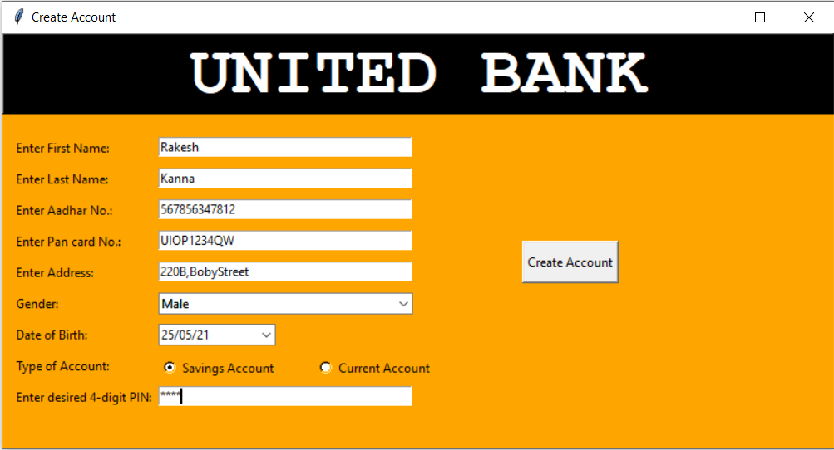
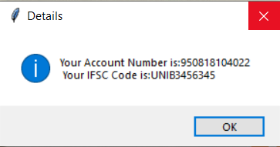
Modules (cont..)

Slide 13
Modules (cont..)
Savings And Current Account:
In Savings Account, Daily Transaction Limit is set to ₹ 20,000 and Monthly Transaction Limit is set to ₹ 1,00,000.
In Current Account, Daily Transaction Limit is set to ₹1,00,00 and Monthly Transaction Limit is set to ₹ 10,00,000.
User can choose either Current or Savings Account.

Slide 14
Modules (cont..)
Log in (Module 2)
If User already has a bank account, he/she can login to their account using Login module.
The User has to fill in their account no. and pin in the login menu and click
Submit button. The Logged in page of the user will appear.
The User can View Balance and their Transaction History, and can Send Money in the Logged in menu.

Slide 15
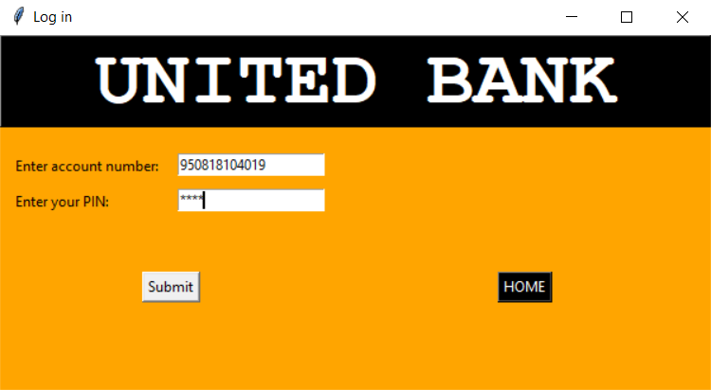
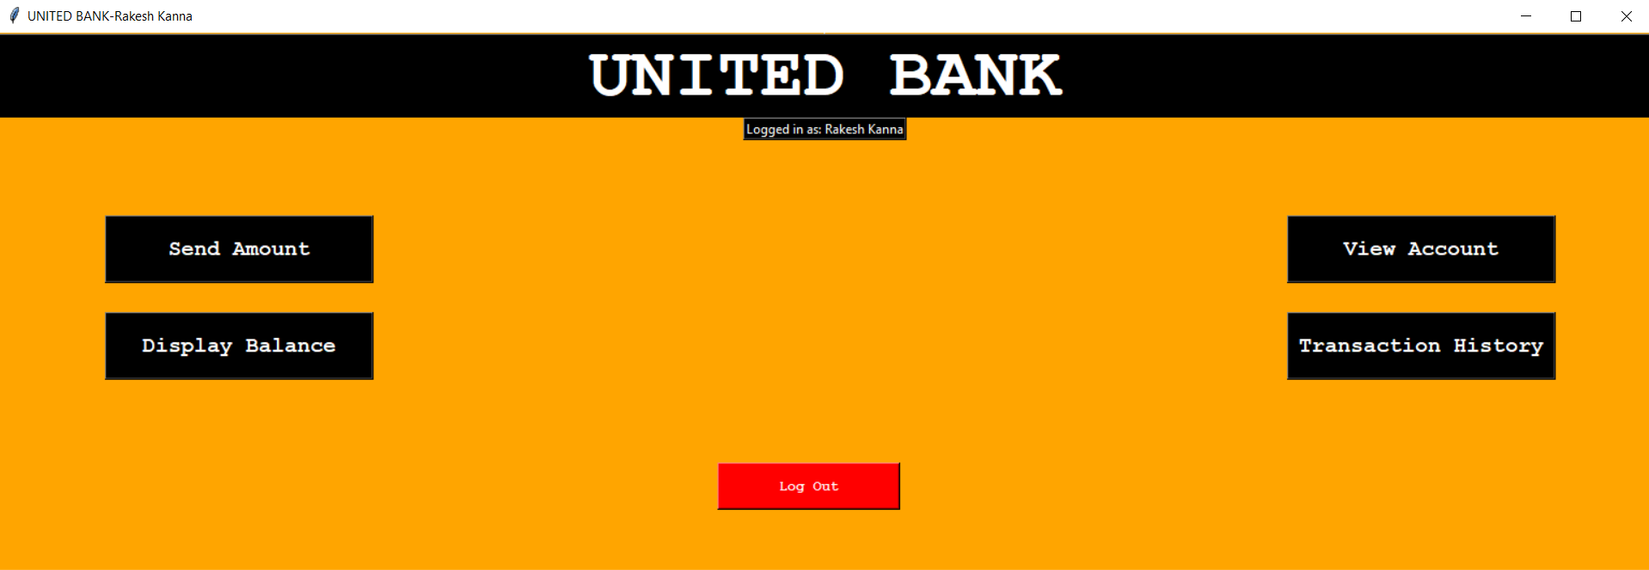
Modules (cont..)

Slide 16
Modules (cont..)
Send Amount (Module 3)
Here the User can send money to different Bank Accounts using the recipient’s Account No. or UPI.
The User has to fill in the recipient’s account no. or UPI and the amount to be send, and click Debit Button.
The Program will check the balance, Monthly and Daily Transaction Limit, and Transfer the amount to the desired Account.

Slide 17
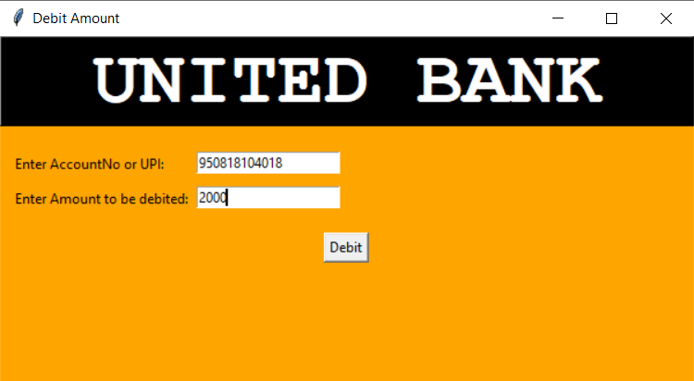
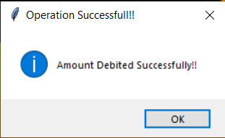
Modules (cont..)

Slide 18
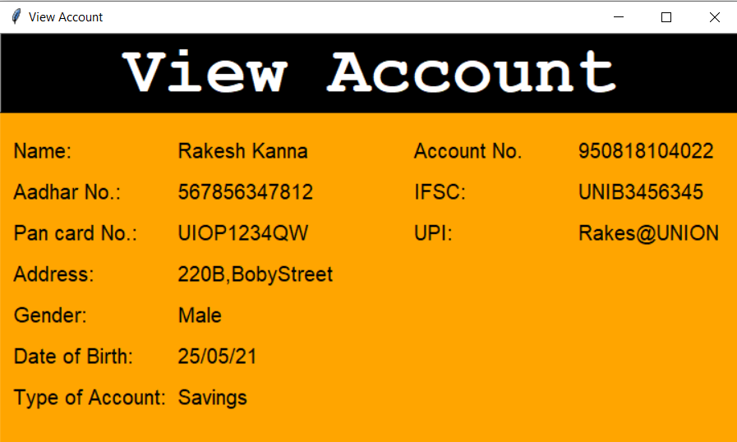
Modules (cont..)
View Account(Module 4)
The User can check their Account Details by clicking on View Account Button in the Logged In Menu of their Account.
The Details are then displayed in View Account window

Slide 19
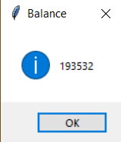
Modules (cont..)
Check Balance(Module 5)
The User can check their Account Balance by clicking on Check Balance Button in the Logged In Menu of their Account.
The Balance is then displayed in a MessageBox.

Slide 20
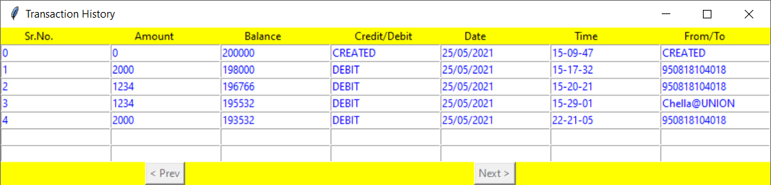
Modules (cont..)
Transaction history(module 6)
The Transaction History of the User can be viewed by clicking on Transaction History Button in the Logged in Menu of the User’s Account.
The Transaction History is displayed in the transaction history window.

Slide 21
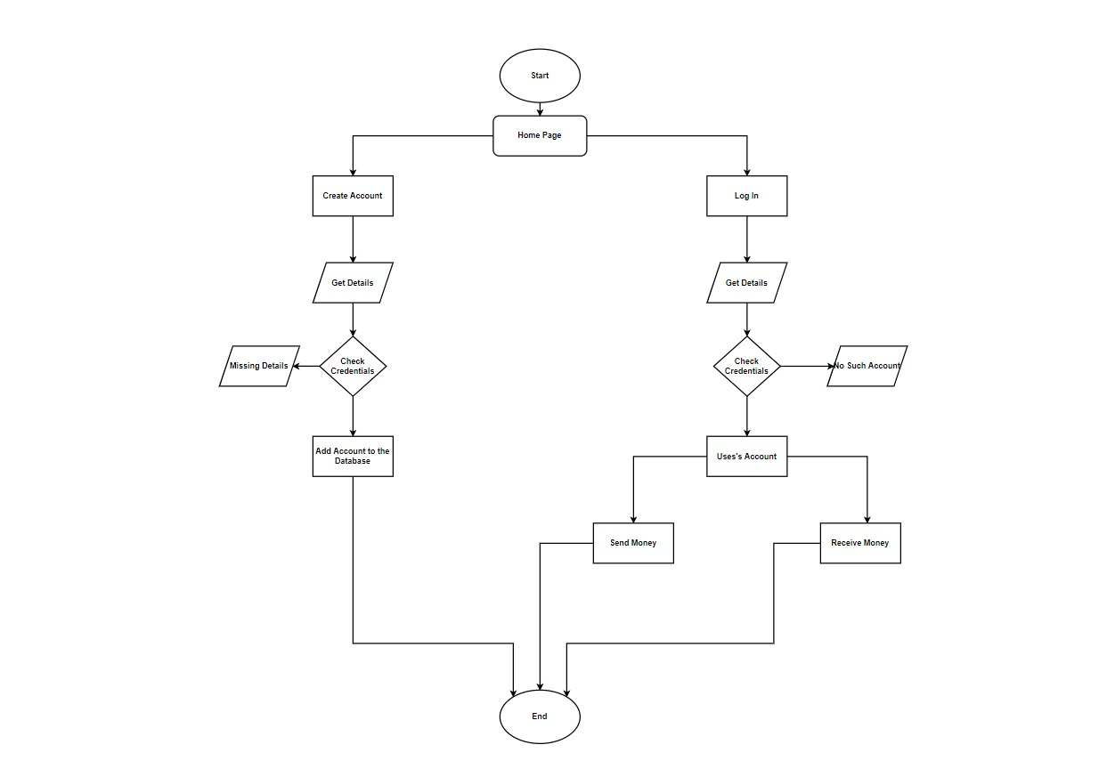
System Architecture

Slide 22
Benefits
Provide flexibility
For better performance
Reducing man power
For doing work more accurately

Slide 23
Conclusion
This banking system will serve as useful approach to deposit and withdraw money for the person .
It reduces the time taken by the user to send money.
Bank system developed is user friendly.
It reduces manual work.

Slide 24
Thank You!

